Slide 1
The Mobile Emporium Database
This slides contains all the information for the Mobile store database
Ujjwal Poudel 301284284
Sumin Gharti Chhetri 301313664
Sudip Ghimire 301310055
Prashant Upreti 301321557
Suraj Regmi 301298825

Slide 2
CONTENTS
01
ER-DIAGRAM
A figure for ER-Diagram.
02
TABLES AND DESCRIPTIONS
Contains information regarding each tables.
03
USE CASES
Different use cases in the store
04
SUMMARY
Conclusion of the DBMS

Slide 3
Mobile Emporium
The Mobile Emporium is an online mobile store offering a wide range of mobile devices and accessories. Our store features various categories, including Smart-Phones, Feature-Phones, Tablets, and Accessories. We have established partnerships with different suppliers to ensure a diverse product selection. Customers can easily browse through the categories, add items to their cart, and make secure payments through our streamlined payment system.
With a focus on timely shipping and efficient order handling, we strive to deliver an excellent shopping experience to every customer. Our Sales entity helps us track performance, enabling us to continuously improve our offerings and meet customer demands.
At The Mobile Emporium, we value our customers and aim to provide them with top-notch products and services.
Whether you’re looking for the latest smartphones, feature-rich tablets, or essential accessories, we’ve got you covered. Happy shopping with The Mobile Emporium!
This store will have 12 entities.
There is also a list of data requirements in the next slides.
This store sells different variety of products. They are smart phones, accessories, feature phone, Tablets.

Slide 4
Data Requirements
1. Many Customers can add many Categories of products in the Cart.
2. The store will have different Employees.
4. There will be different Categories of products in the stores.
5. Different Categories will have different products.
6. Different products will have different brands.
7. Different products will also have different Models.
8. Different products will also have different Suppliers.
10. All the sales are stored in Sales.

Slide 5
Entities Information
Entities | Information
Employee | Contains information about employees of the store
Category | Contains information about different categories of products in the store
Smartphone | Contains information about the Smartphone Category
Featurephone | Contains information about the Feature Phone Category
Accessories | Contains information about Accessories
Tablets | Contains information about Tablets
Sales | Contains information about Sales
Shipping | Contains information about shipping details
Payment | Contains information about payment details
Cart | Contains information about Cart
Customer | Contains information about Customer details
Supplier | Contains information about Supplier details

Slide 6
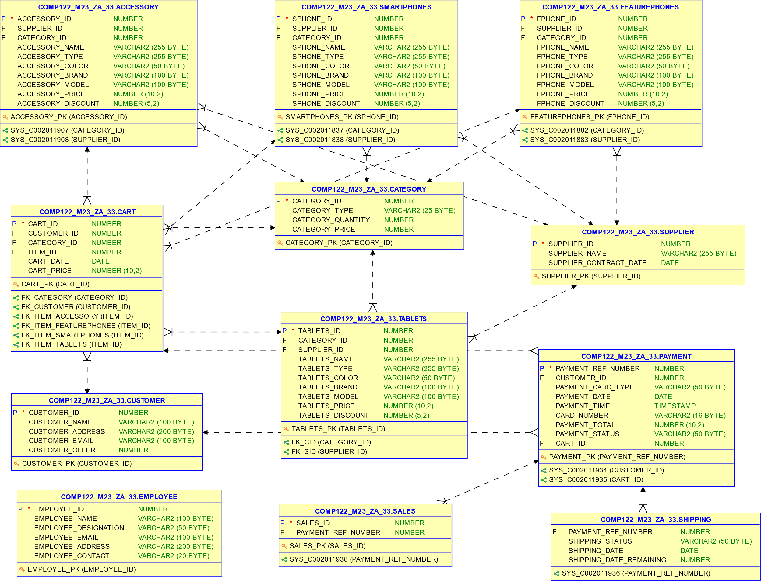
ER-DIAGRAM

Slide 7
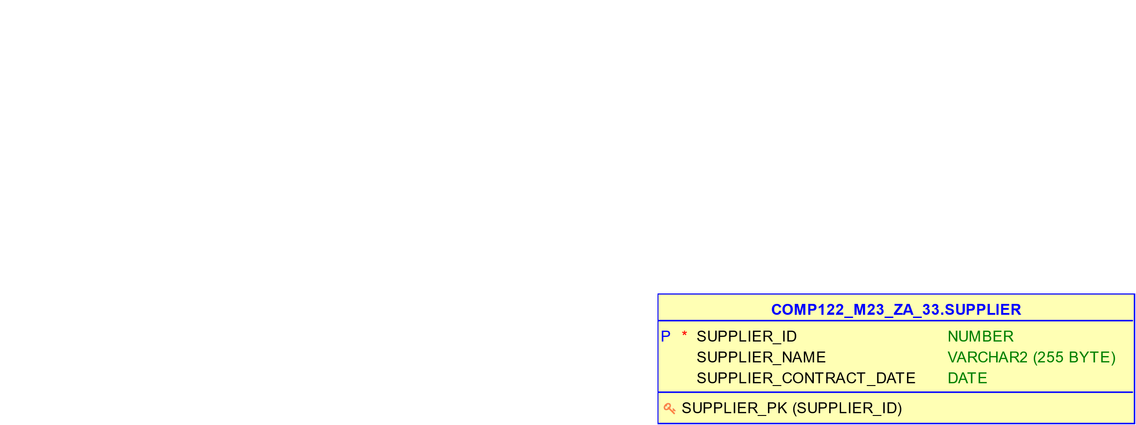
SUPPLIER TABLE
This table serves as a repository for supplier-related data vital to the company's operations. The primary key, Supplier_Id, offers distinct identification for each supplier. The Supplier_Name column captures the supplier's name. Furthermore, Supplier_Contract_Date documents the date of the contract establishment between the company and the respective supplier. This arrangement facilitates effective supplier management and contract tracking.

Slide 8
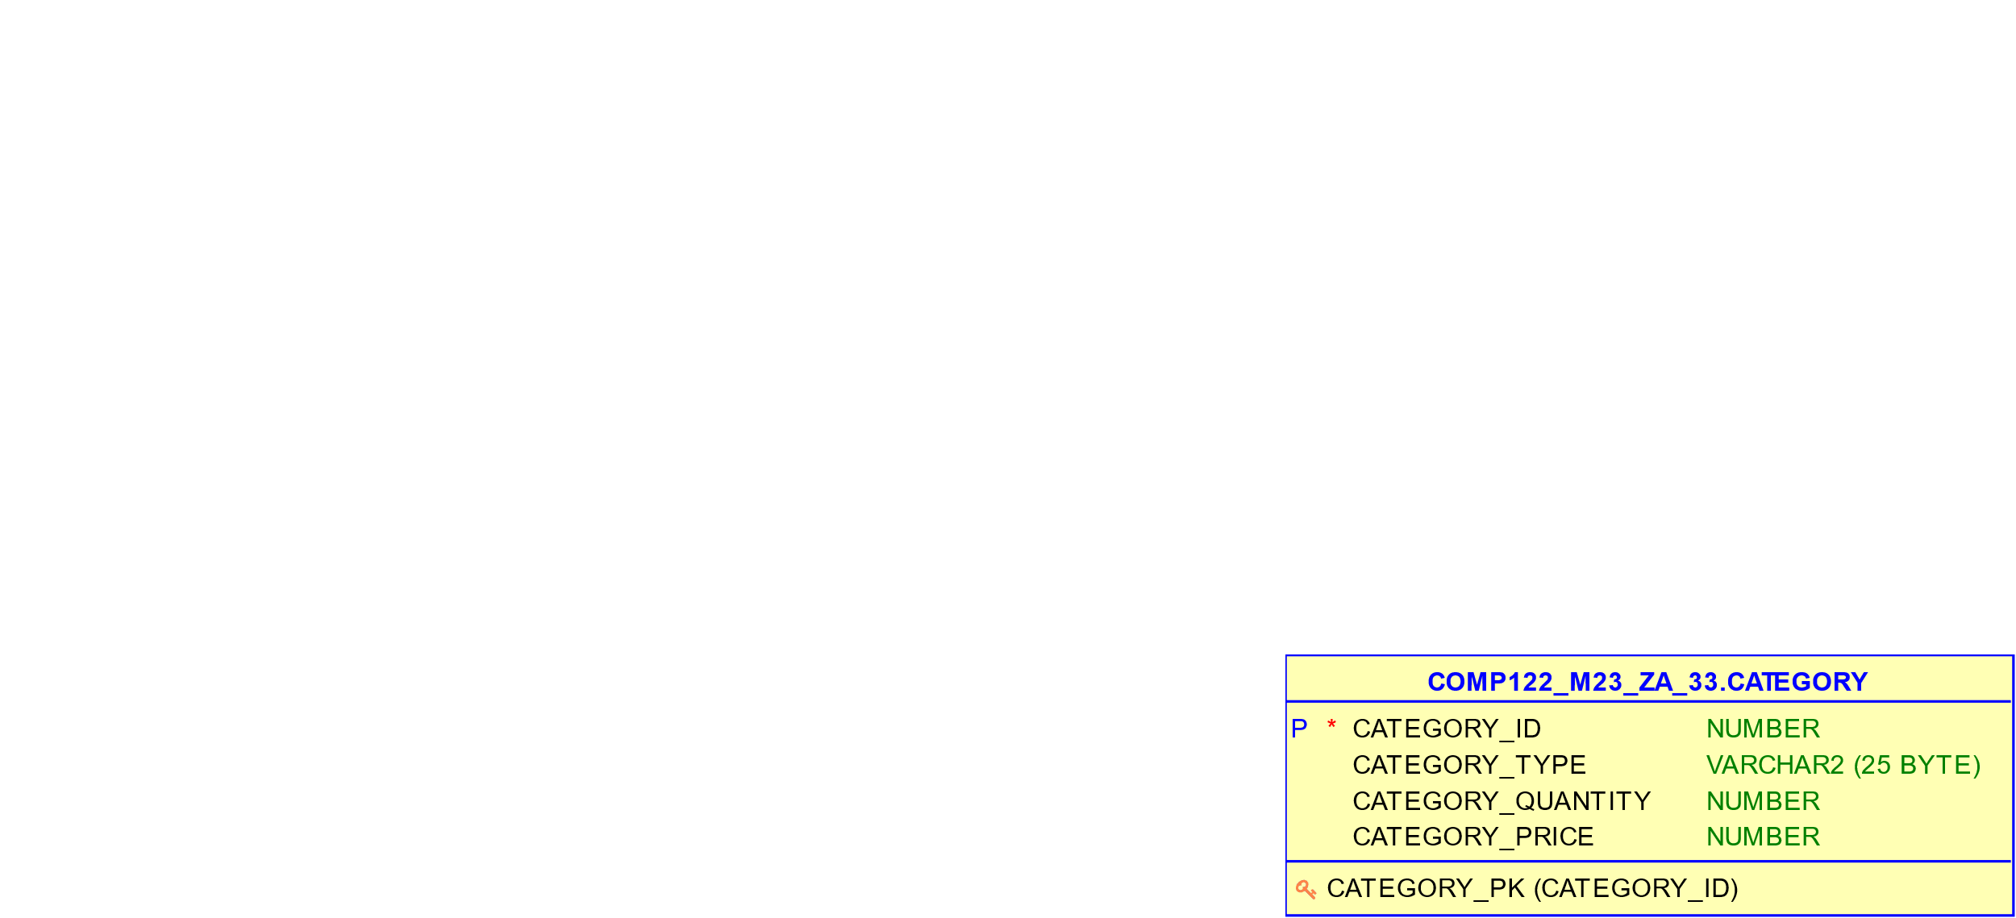
Category TABLE
The table serves as a product categorization hub, featuring a primary key, Category_Id, for distinct category identification. The Category_Type column captures product types (e.g., Smartphone, Tablet). Category_Quantity stores available product amounts, while Category_Price holds base prices. This setup streamlines inventory and pricing management for different product categories.

Slide 9
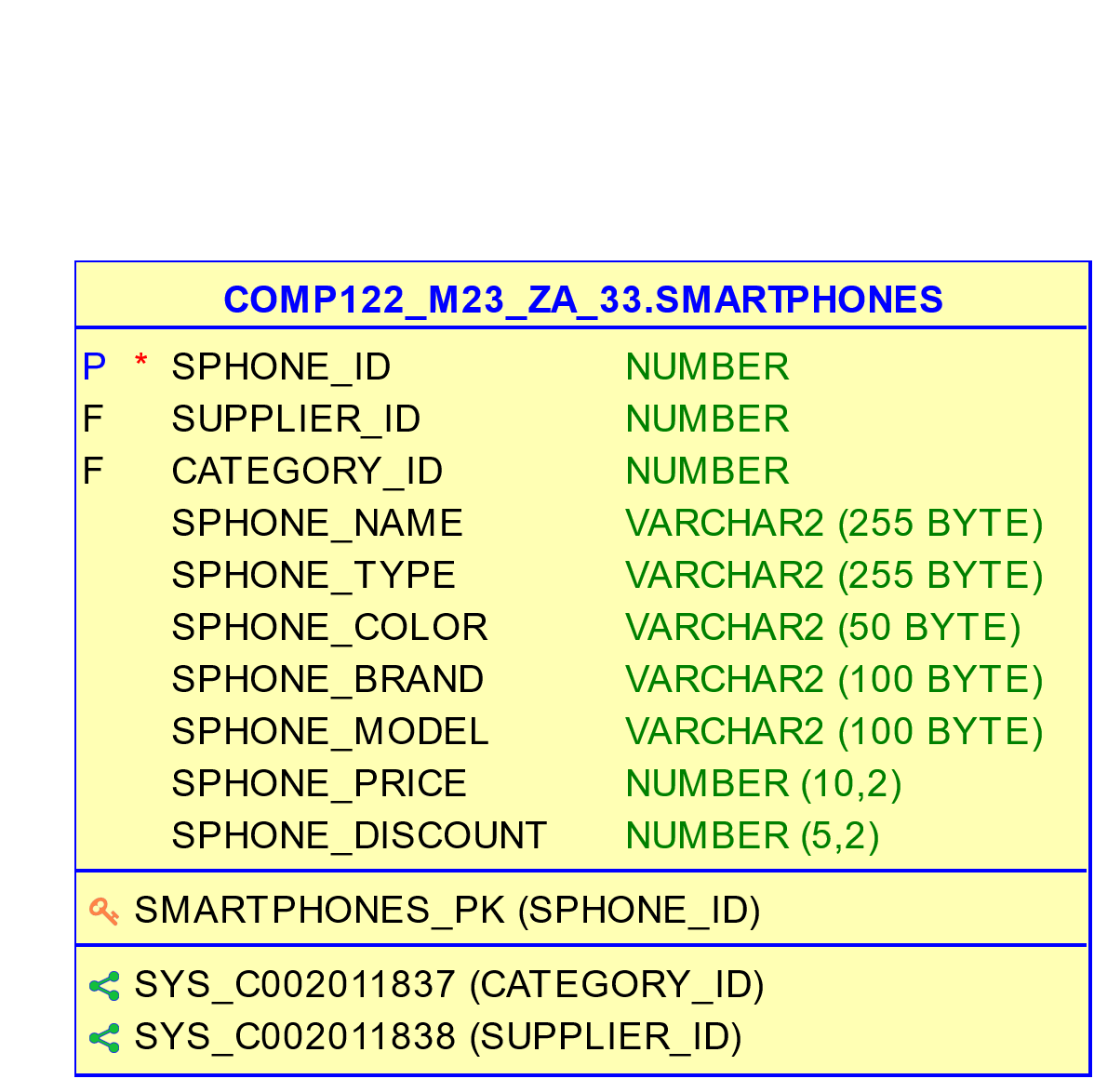
SmartPhone TABLE
This table contains details about various smartphone models. It employs a primary key, SPhone_Id, for distinct identification of each smartphone entry. The foreign keys Supplier_Id and Category_Id link to the Supplier and Category tables, respectively, indicating the supplier and category of the smartphone. SPhone_Name captures the smartphone's name, while SPhone_Type specifies its type. The smartphone's color, brand, model, price (SPhone_Price), and applied discount (SPhone_Discount) are also stored. This setup aids in managing and cataloging diverse smartphone models, their attributes, and pricing-related information.

Slide 10
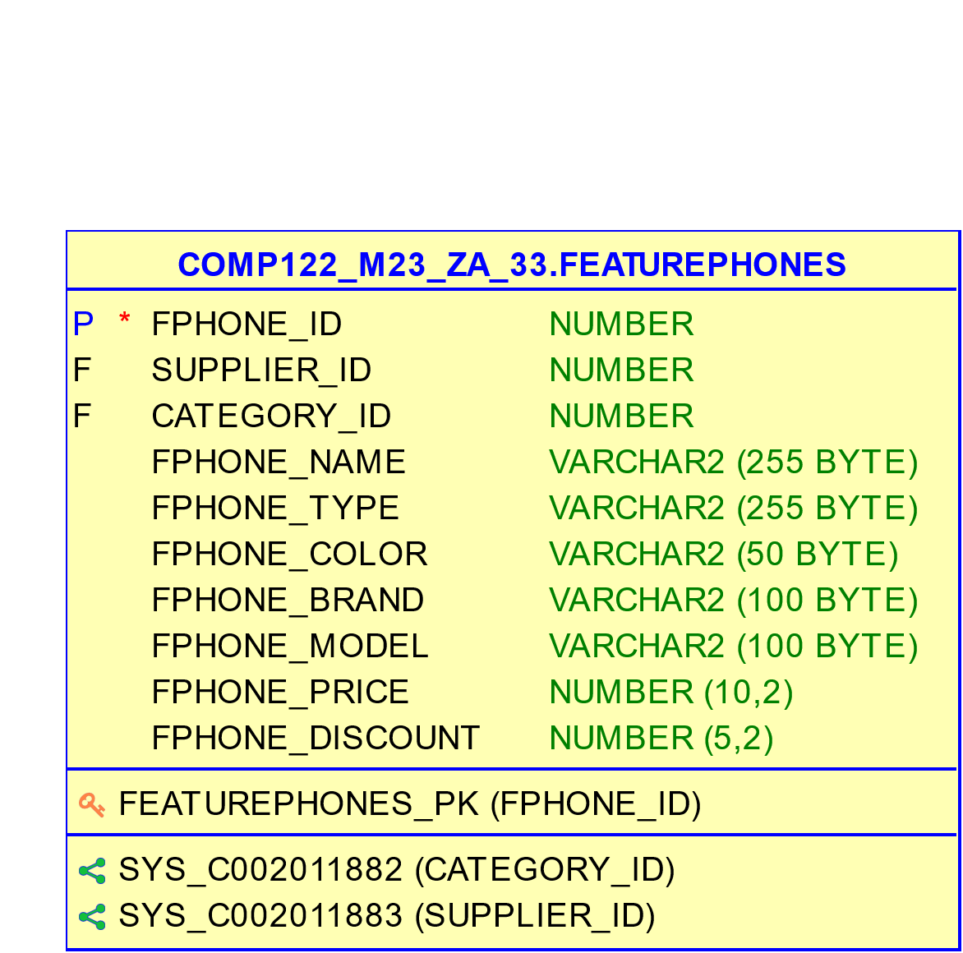
Feature Phone TABLE
This table contains details about various models of feature phones. Each entry is uniquely identified by the Fphone_Id primary key. The table incorporates foreign keys, including Supplier_Id referring to the Supplier table and Category_Id referring to the Category table. Noteworthy attributes encompass Fphone_Name, Fphone_Type, Fphone_Color, and Fphone_Brand, which respectively denote the feature phone's name, type, color, and brand. The table also includes entries specifying the feature phone's model, price (Fphone_Price), and the associated discount (Fphone_Discount). This design enables effective management of diverse feature phone models, their attributes, and pricing information.

Slide 11
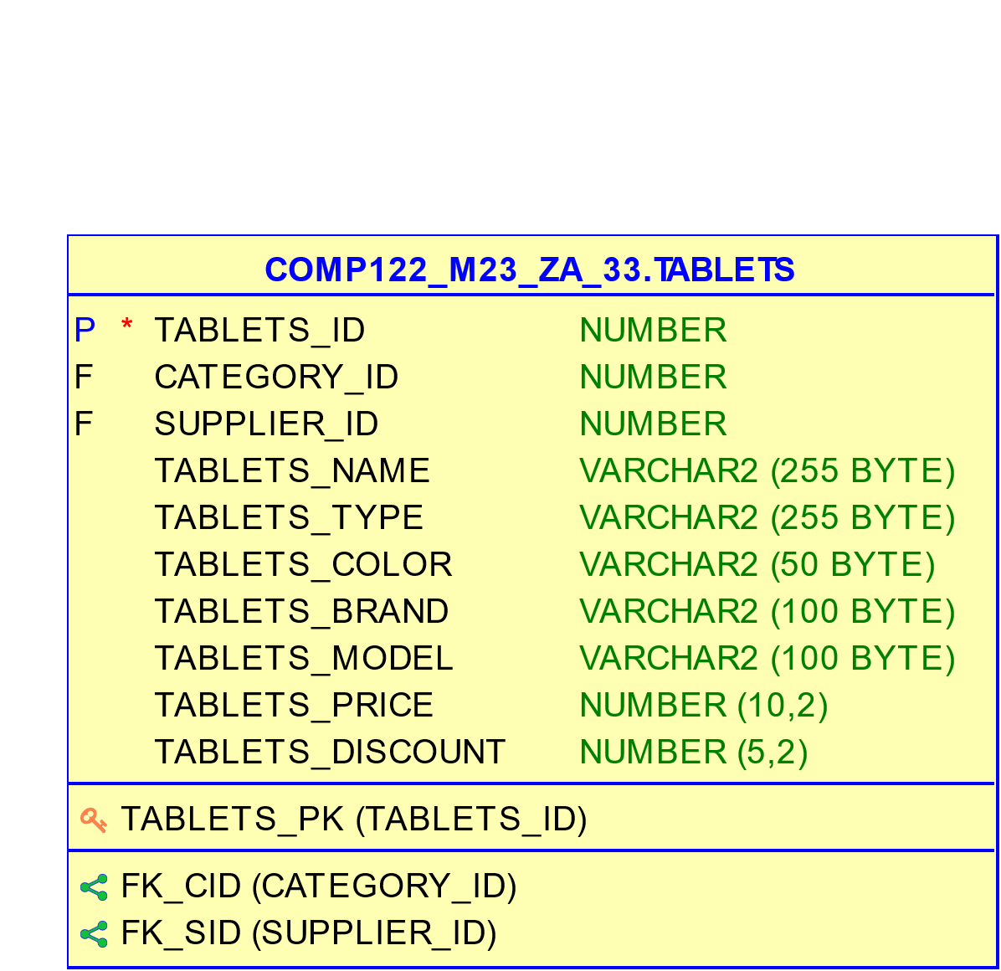
Tablets TABLE
This table records information regarding various tablet models. It employs a primary key, Tablets_Id, to ensure unique identification for each tablet entry. The table links with the Category and Supplier tables through foreign keys Category_Id and Supplier_Id, respectively. Key attributes like Tablets_Name, Tablets_Type, Tablets_Color, and Tablets_Brand store the tablet's name, type, color, and brand. Additionally, details about the tablet's model, price (Tablets_Price), and applied discount (Tablets_Discount) are included. This arrangement allows efficient management of diverse tablet models, their specifications, and pricing particulars.

Slide 12
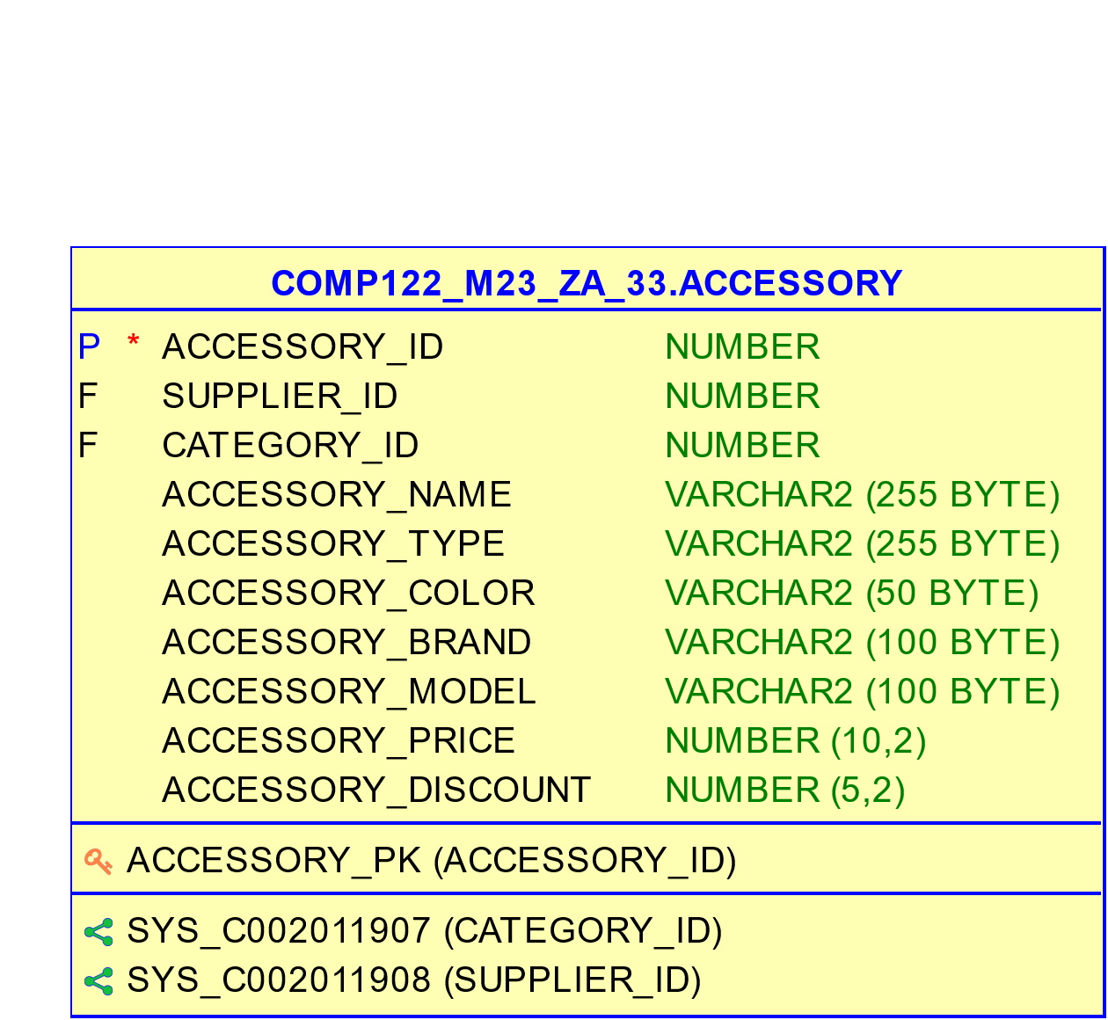
Accessory TABLE
This table contains information pertaining to various accessories. Each accessory is uniquely identified by the Accessory_Id primary key. The table includes foreign keys such as Supplier_Id, referencing the Supplier table, and Category_Id, referencing the Category table. The attributes encompass Accessory_Name, Accessory_Type, Accessory_Color, and Accessory_Brand, signifying the accessory's name, type, color, and brand respectively. Furthermore, the table comprises entries for the accessory's model, price (Accessory_Price), and associated discount (Accessory_Discount). This schema facilitates efficient organization of diverse accessory details including their suppliers, categorization, and pricing information.

Slide 13
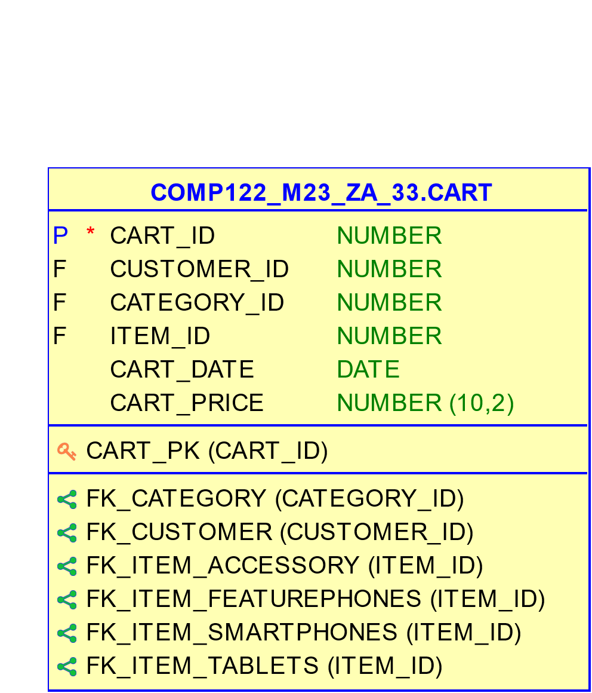
Cart TABLE
This table captures shopping carts, linking customers and their selected items. Key fields include Cart_ID (unique cart identifier), Customer_ID (linked customer), Category_Id (item category), and Item_ID (specific item). Attributes like Cart_Quantity (item count), Cart_Date (addition date), and Cart_Price (total cost) provide insights into shopping behavior. Enables customer-centric analysis and business optimization.

Slide 14
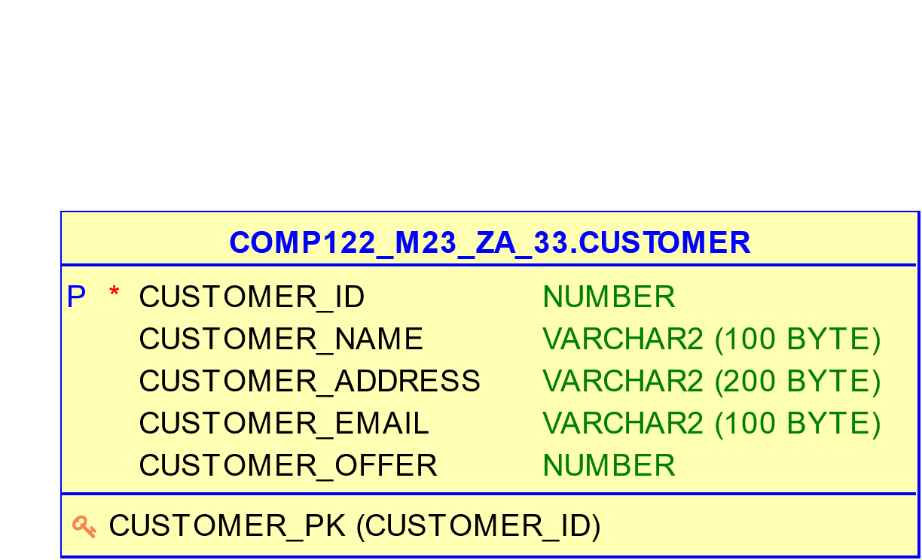
Customer TABLE
This table captures fundamental information regarding customers engaged with the organization. The cornerstone attribute, Customer_ID, functions as the primary key, ensuring the distinct identification of each customer. Pertinent details include Customer_Name, representing the customer's name, and Customer_Address, containing their corresponding address. The Customer_Email attribute houses the customer's email address for communication purposes. Moreover, the table encompasses Customer_Offer, dedicated to storing any applicable offers or discounts associated with the customer. This structured approach facilitates efficient management and interaction with customers, aiding in personalized services and promotional activities.

Slide 15
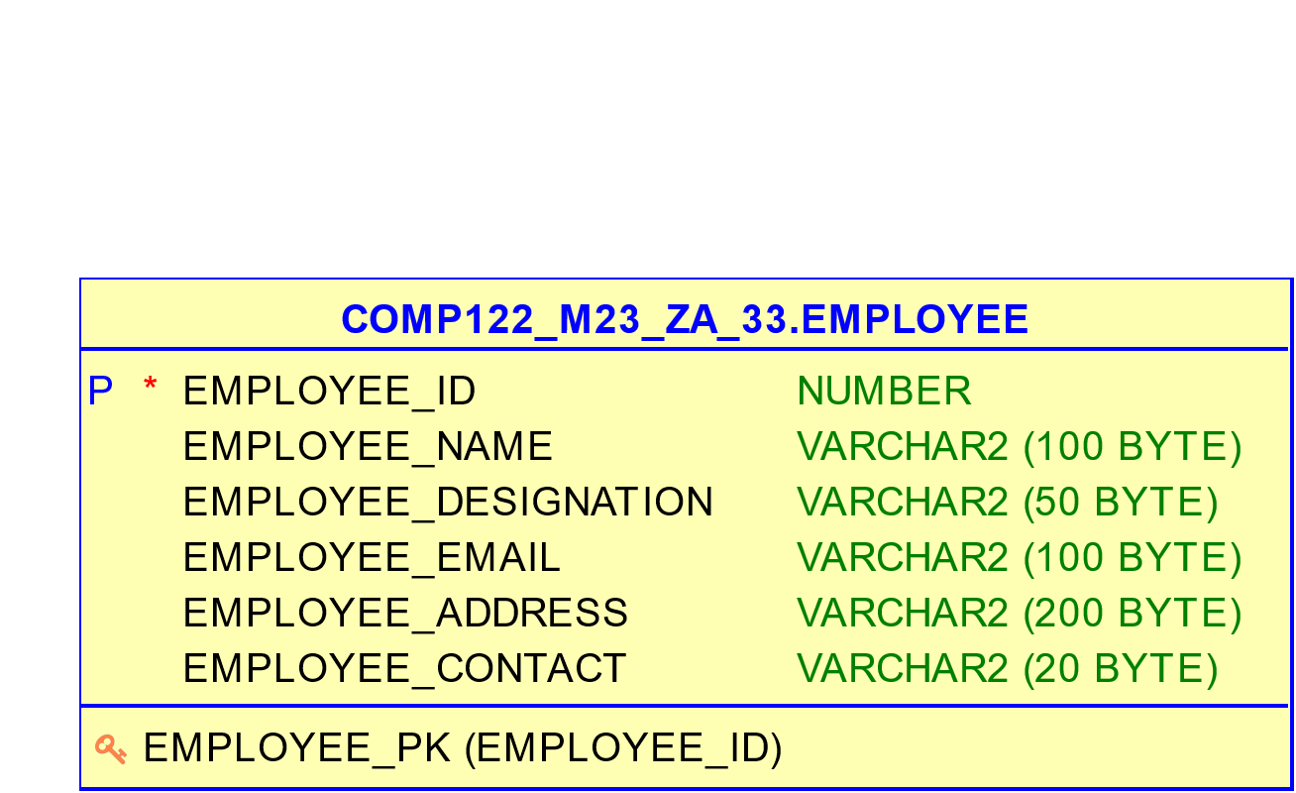
Employee TABLE
This table captures essential details about employees within the organization. The Employee_ID serves as the primary key, guaranteeing uniqueness for each employee record. The table encompasses attributes such as Employee_Name, Employee_Designation, and Employee_Email, which respectively store the employee's name, job role, and email address. Additionally, the table includes fields for Employee_Address, housing the employee's physical address, and Employee_Contact, holding their contact number. This comprehensive structure facilitates the management and retrieval of crucial employee information for organizational purposes.

Slide 16
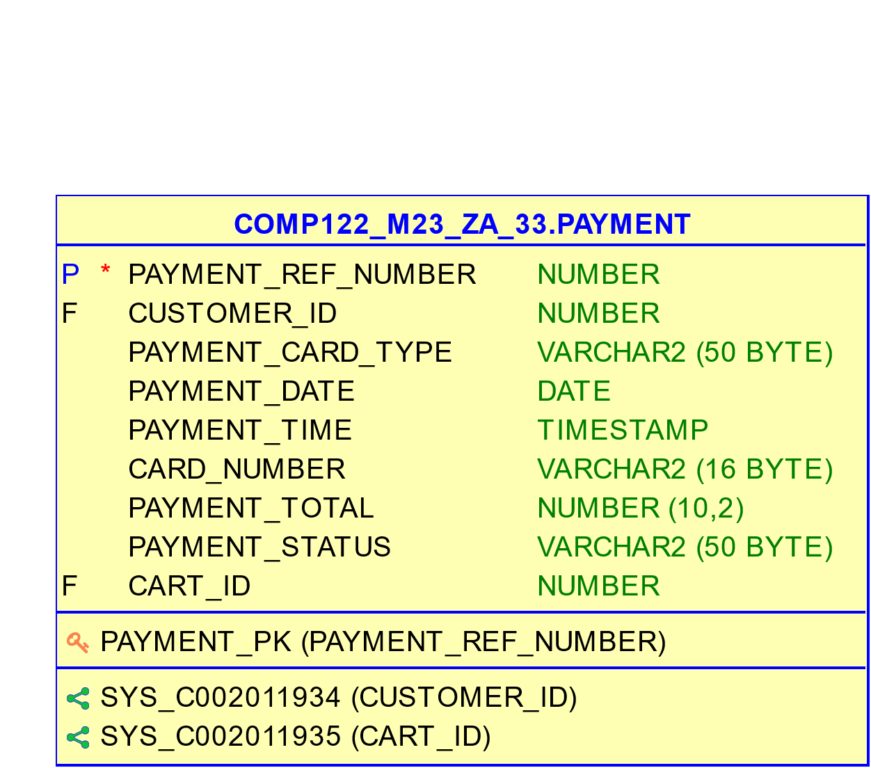
Payment TABLE
This table outlines payment details for both fulfilled and pending transactions. Noteworthy fields encompass Payment_Ref_Number (unique payment identifier), Customer_ID (linked customer), and Cart_ID (associated cart). Attributes like Payment_Card_Type (card used), Payment_Date (payment day), Payment_Total (amount paid), and Payment_Status (transaction status) offer insights into financial trends. Supports transaction tracking and customer payment behavior analysis for informed decision-making.

Slide 17
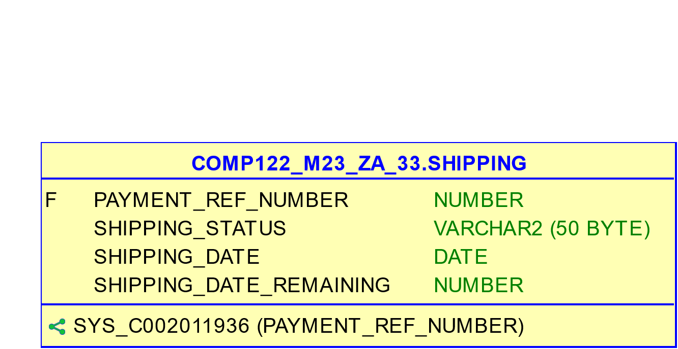
Shipping TABLE
Payment_Ref_Number acts as a foreign key relating to the Payment table, signifying the connected payment for shipping. The Shipping_Status field captures shipping completeness (e.g., Complete, Incomplete), while Shipping_Date documents shipping initiation. Shipping_Date_Remaining conveys remaining days for shipping completion. This data aids in monitoring shipping progress, projecting delivery timeframes, and ensuring timely order fulfillment.

Slide 18
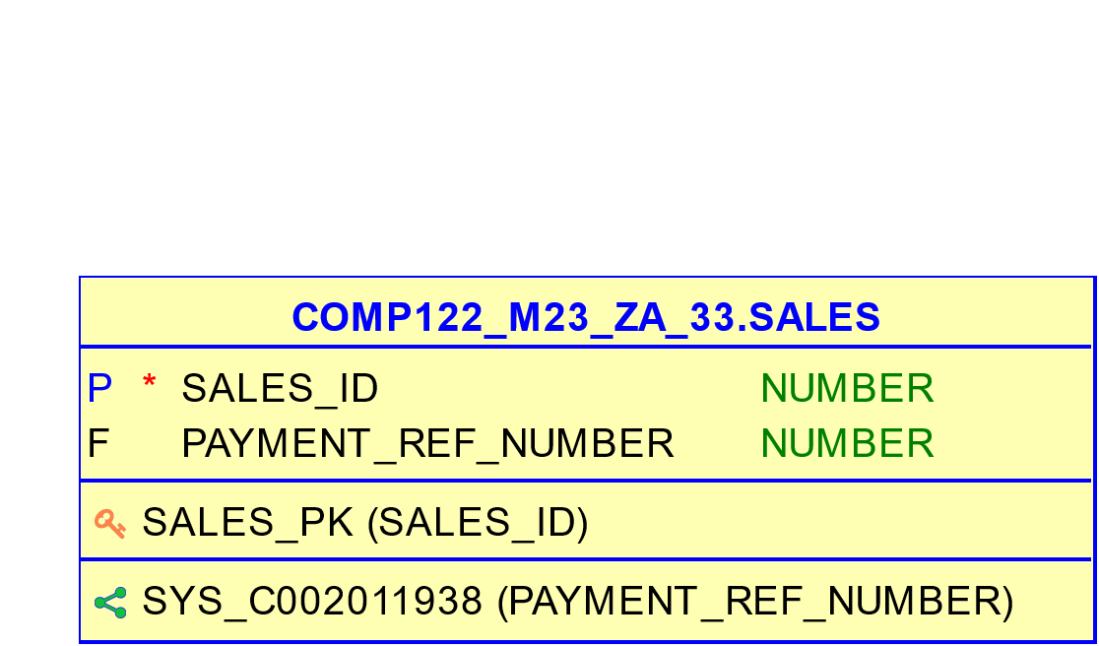
Sales TABLE
Sales_ID serves as the primary key, ensuring unique identification for each sales record. The Payment_Ref_Number field acts as a foreign key, linking to the Payment table. This linkage establishes a connection between sales entries and their corresponding payment transactions, facilitating accurate tracking and reconciliation of sales activities.

Slide 19
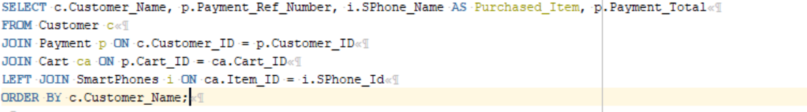
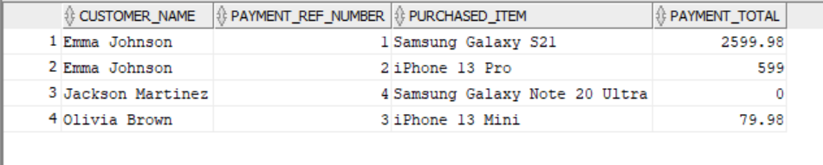
Use case 1: Retrieve Customer and their Purchased Items.

Slide 20
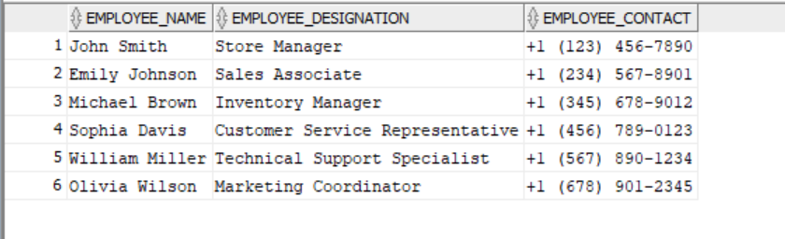
Use case 2: Get Employee Contact Information

Slide 21
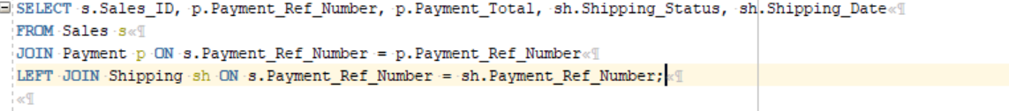
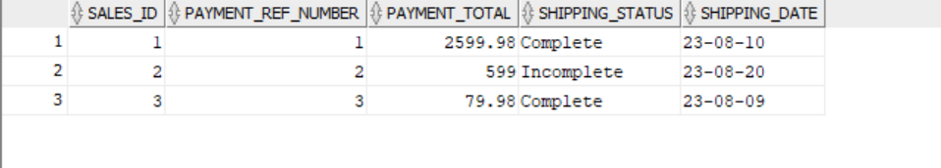
Use case 3: Retrieve Sales and Shipping Details

Slide 22
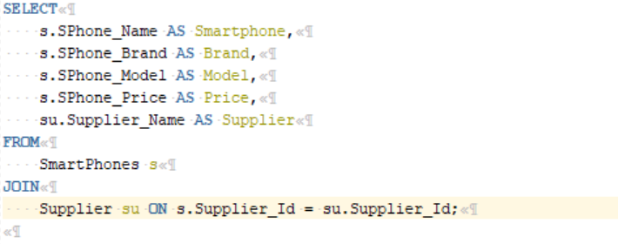
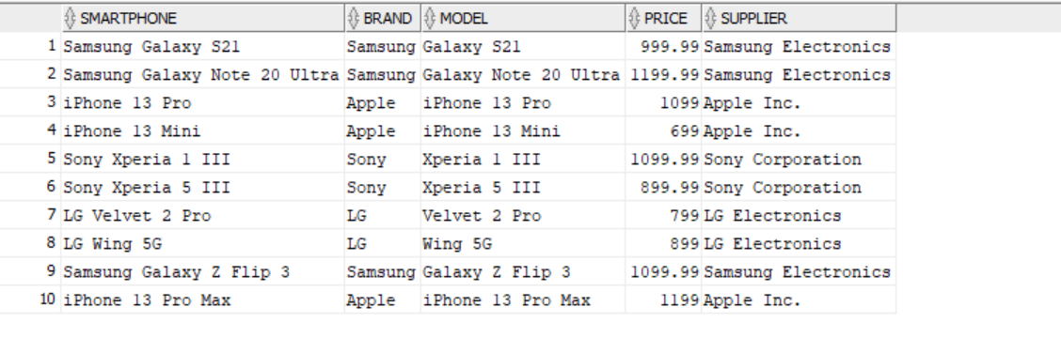
Use case 4: Displaying Information about Smartphones and Their Suppliers

Slide 23
THANK YOU

